Slide 1
Chapter 5

Slide 2
Objectives

Slide 3
Objectives (cont.)

Slide 4
Relational operators

Slide 5
Examples that use relational operators

Slide 6
Logical operators

Slide 7
Examples that use logical operators

Slide 8
The syntax of the if-else statement

Slide 9
An if statement with an else clause

Slide 10
Nested if statements

Slide 11
The syntax of the switch statement

Slide 12
A switch statement with a default label

Slide 13
A switch statement that falls through the first case label

Slide 14
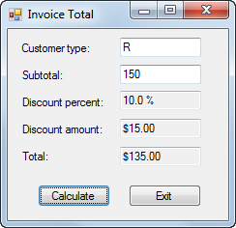
The enhanced Invoice Total form

Slide 15
The event handler for the Click event of the Calculate button

Slide 16
The event handler for the Click event of the Calculate button (cont.)

Slide 17
The syntax of the while statement

Slide 18
The syntax of the do-while statement

Slide 19
The syntax of the for statement

Slide 20
A for loop that adds the numbers 8, 6, 4, and 2

Slide 21
A loop with a break statement

Slide 22
A loop with a continue statement

Slide 23
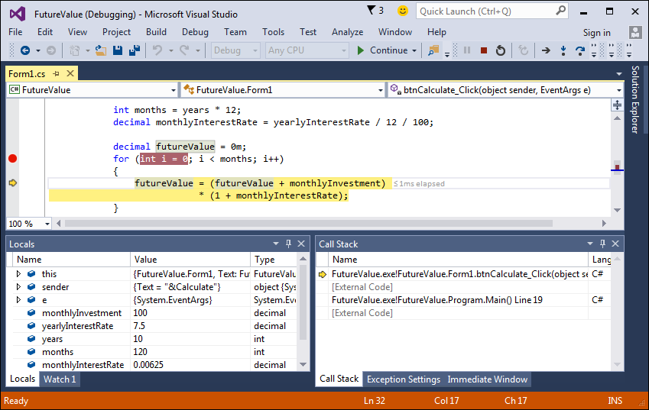
A for loop with a breakpoint and an execution point

Slide 24
How to set and clear breakpoints

Slide 25
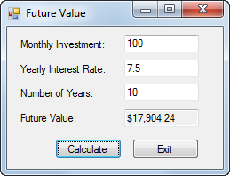
The Future Value form

Slide 26
The property settings for the controls

Slide 27
Additional property settings

Slide 28
The code for the event handlers in the Future Value application

Slide 29
Extra 5-1 Calculate the factorial of a number

Slide 30
Extra 5-2 Calculate change

Slide 31
Extra 5-3 Calculate income tax

